Slide 1
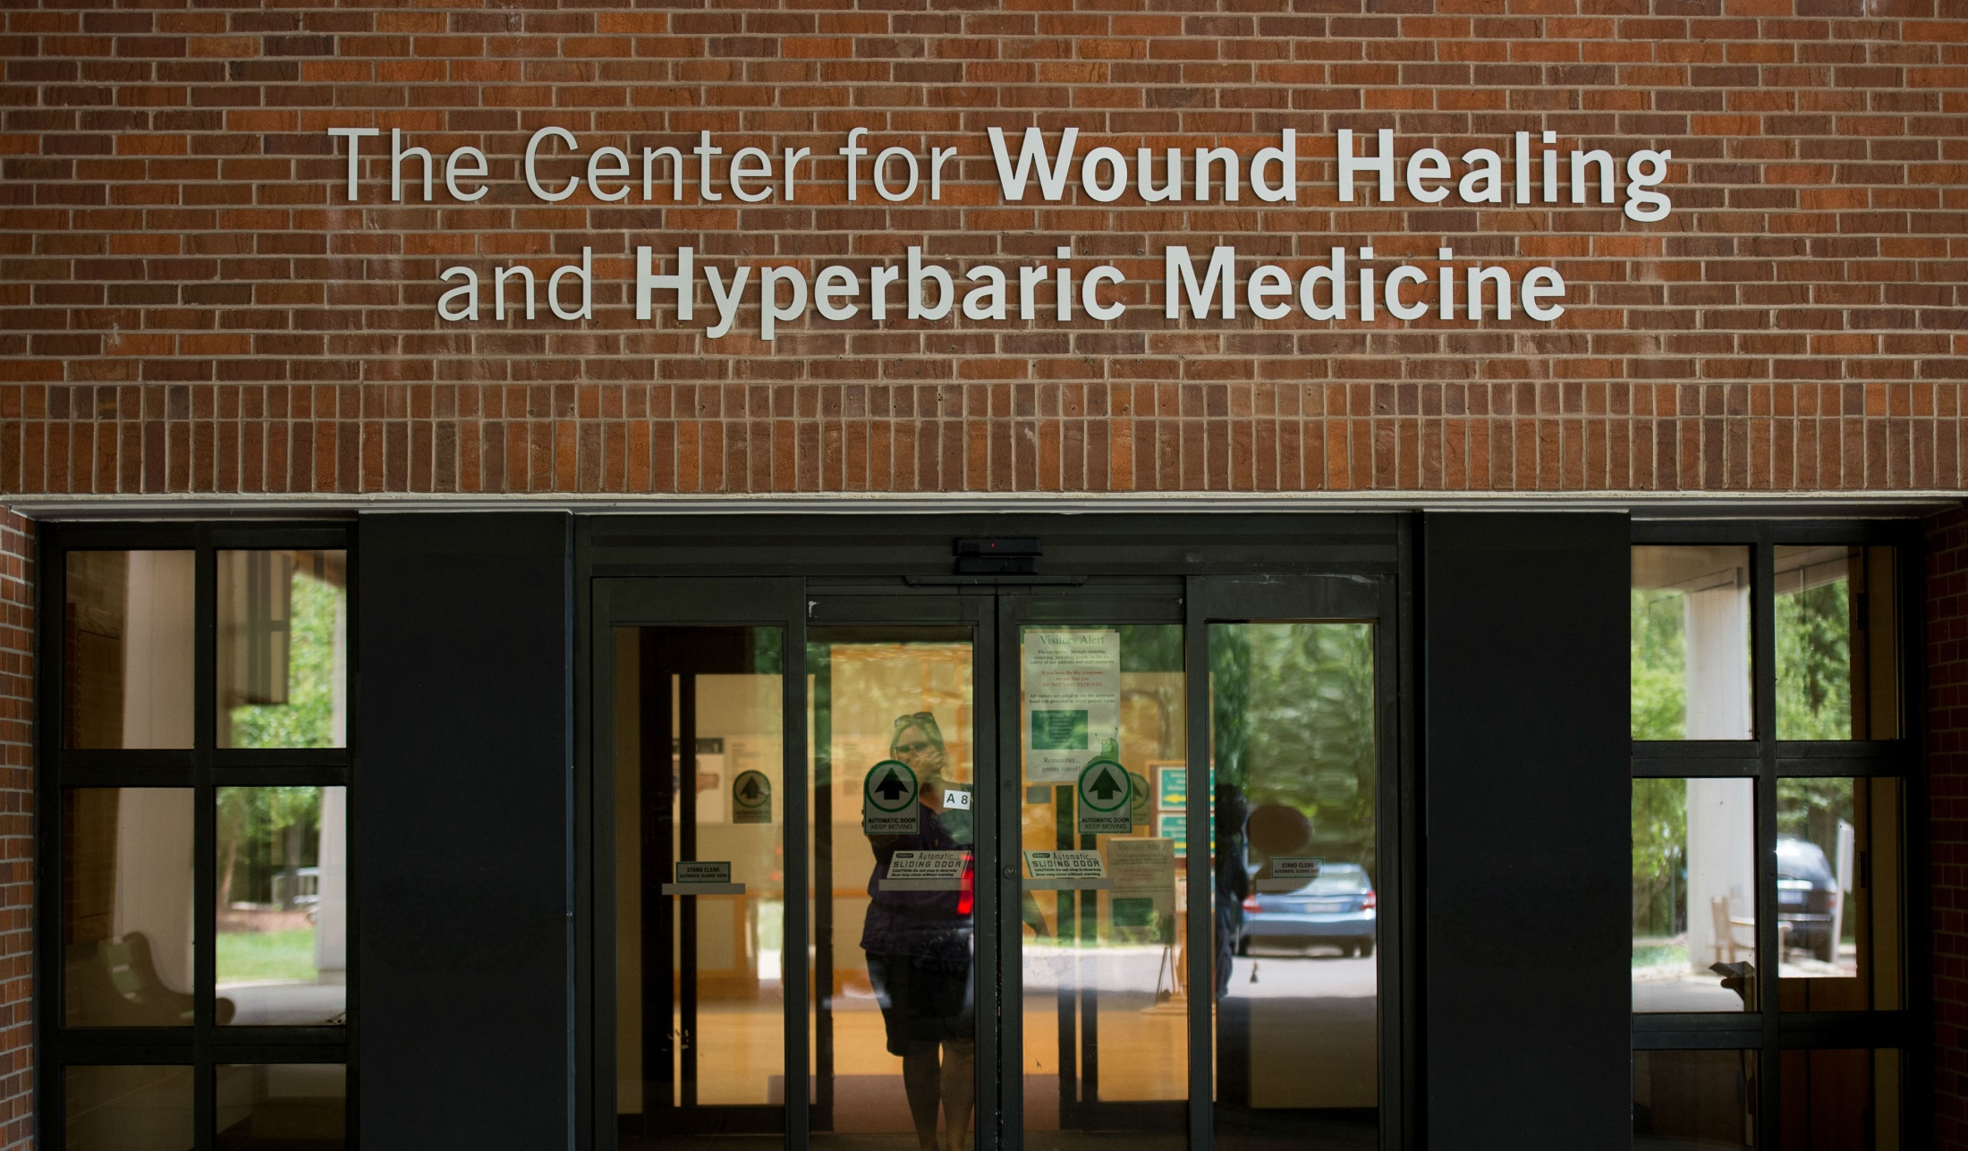
The Doylestown Hospital Center for Wound Healing and Hyperbaric Medicine provides specialized treatment for chronic or non-healing wounds.

Slide 2
Convenient parking is available in Lot C with handicapped parking available in Lot D. Patients benefit from easy curbside drop off at the dedicated Wound Center entrance.

Slide 3
As you arrive, please check in at our patient registration window. For more information or to schedule a consultation with our wound healing team, please call 267-885-1775.

Slide 4
Our experts specialize in healing wounds that have not responded to standard medical care within 30 days. We offer advanced therapies to treat chronic wounds, diabetic wounds and optional post-operative treatments.

Slide 5
Enjoy a welcoming reception area as you wait. Please be sure to bring your medical records, insurance information and a list of current medications and allergies to your first appointment.

Slide 6
Our bright, spacious treatment rooms enable us to accommodate all types of patients. Your first appointment consists of an assessment by our skilled wound care team, a review of your medical history, blood tests, and recommendations for your treatment.

Slide 7
Our friendly, knowledgeable staff considers patient care our number one priority. Each patient receives an individualized plan of care based on your specific healing goals, and we are happy to answer any questions you may have about your care.

Slide 8
In the Hyperbaric Room, we use state-of-the-art technology and evidence-based clinical protocols to promote healing in our patients.

Slide 9
Our staff is specially-trained with many years of experience helping patients with wound therapies.

Slide 10
The center has two hyperbaric chambers. Treatments include negative pressure wound therapy, bio-engineered tissues, biosynthetic dressings and hyperbaric oxygen therapy.

Slide 11
Hyperbaric oxygen therapy is a clinically-proven and effective non-invasive treatment that enhances the body’s natural ability to heal.

Slide 12
Our award-winning services always focus on the comfort and care of our patients. We provide education to support healing at home and ongoing communication with your doctor about your progress.

Slide 13
For more information about The Doylestown Hospital Center for Wound Healing & Hyperbaric Medicine please call 267-885-1775.

